Slide 1
Using Deep Learning to Correlate Reddit Posts with Economic Time Series during the COVID-19 Pandemic

Slide 2
CSE 431
Team - 20
Task -02
Member 1 : Sanjoy Dev - 19101507
Member 2 : Maliha Bushra Hoque - 19101543
Member 3 : Shishir Kumar Das - 22241123

Slide 3
Why ? Why getting genuine information about economic condition is important?
Knowing the condition of the economy is a good predictor of future demand for goods and services.
Depending on social media for everyday resources can be unfavourable.
False information about economics can drive a nation into recession.
False information propagates faster and lasts longer.

Slide 4
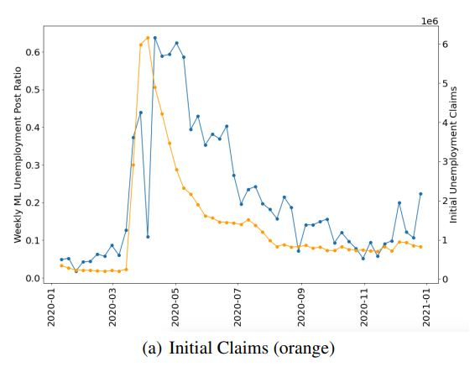
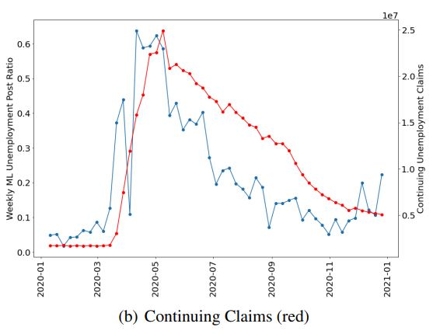
WHAT ? This research paper has used this Raddit to compare and make a strong correlation with official unemployment statistics during the economically anomalous year of 2020.
In the Raddit dataset, CNN model has been applied. The relation between CNN model predictions and the official unemployment rate has been shown in the graph. The first graph shows the relation between CNN (blue) with Initial Claims (orange) and the second graph shows the relation between the same CNN and Continuing claims (red).
We can see that, CNN predictions match up better with continuing claims (red) than with initial claims (orange).

Slide 5


Dataset
Reddit and FRED (Federal Reserve Economic Data)
99,282 posts from subreddit “r/personalfinance”
Removed post from reddit filtered
No personal information used
Annotated into 4 criterias:
Unemployment (U)
Cut/Furlough (C)
Employment (E)
Other (O)
Unemployment Data from FRED (St. Louis)
Initial Claim (ICSA)
Continuing Claim (CCSA)
Temporal Alignment maintained

Slide 6
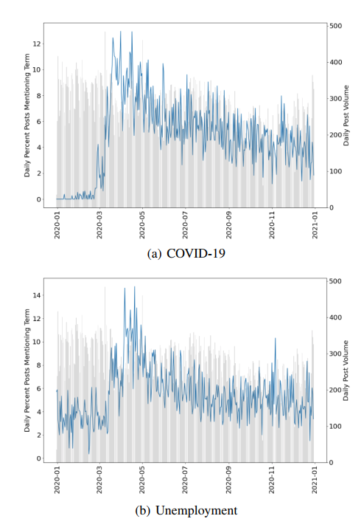
Data Analysis
Stopword Removal
Regular Expression based removal of special characters.
Figure Analysis
Set of COVID-19 related keywords
Set of unemployment related keywords

Slide 7
Model Implementation
Why CNN?
CNN is used because it works effectively on small datasets, having fewer parameters to train than Recurrent Neural Network-based models
Model Details
classical machine learning model(Scikit learn-primary package) | CNN architecture(Stochastic gradient- primary package)
TB1: Random Forest Classification Model | CNN1: CNN model with no extra preprocessing
TB2: A logistic regression classification model | CNN2: stopword removal and regular expression based special character removal
TB3: A linear support vector machine(SVM) classification Model. | CNN3: sentiment scores are concatenated to the output of the max pulling layer
All models were trained and evaluated using randomly assigned 90/10 train/test splits.

Slide 8
Summary,Result and Future Plan
1. After implementing models it achieved a best weighted F1 score of 0.857 on two-class classification of posts.
2.We make our data and source code available to the research community to foster additional work in this area
and to facilitate replication.
3. The CNN model was efficient and F1 scores indicate that the model structure and inputs were enough to achieve strong performance measures, extending model input to include longer word sequences or further expanding our labeled dataset could similarly help to achieve higher performance. This could also enable the use of more advanced machine learning models like gated recurrent units (GRUs), long short-term memory networks (LSTMs).

